Slide 1

Deloitte Pre Hire Training 2017
FOUNDATION TRAINING
Spring MVC

Slide 2
Spring 3 MVC
Validation and Exception Handling

Slide 3
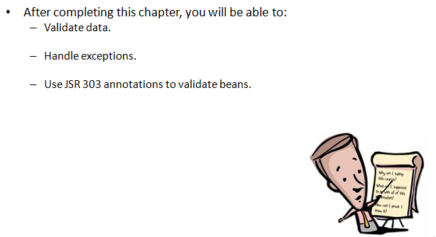
Objectives

Slide 4
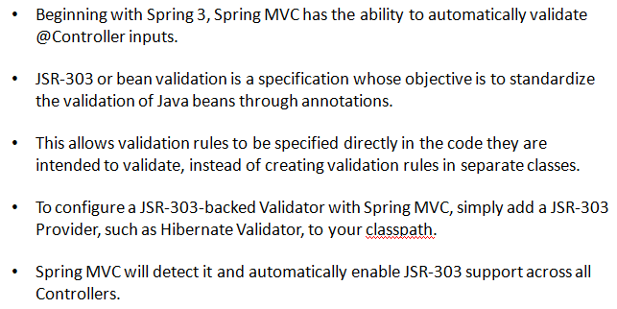
Validation With Annotations

Slide 5
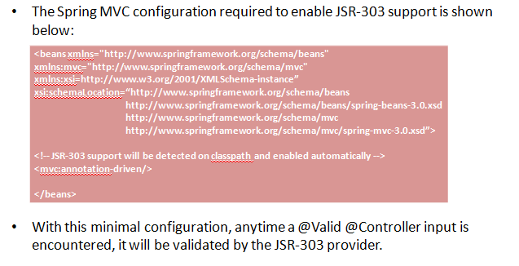
Validation With Annotations

Slide 6
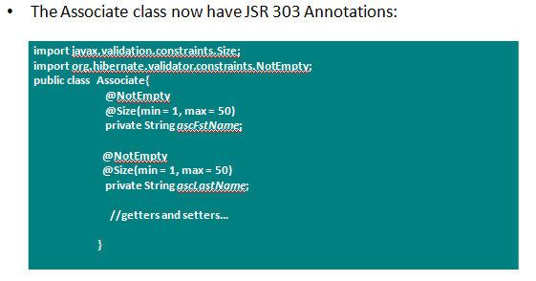
Validation With Annotations

Slide 7
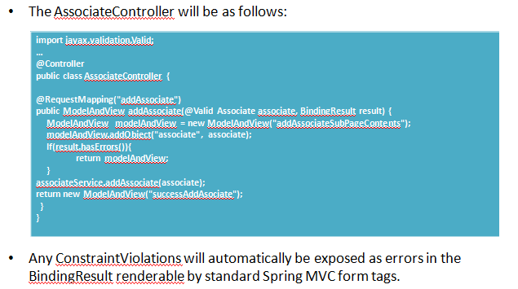
Validation With Annotations

Slide 8
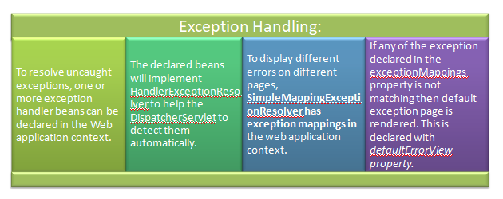
Exception Handling

Slide 9
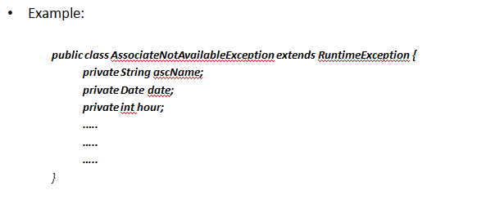
Exception Handling

Slide 10
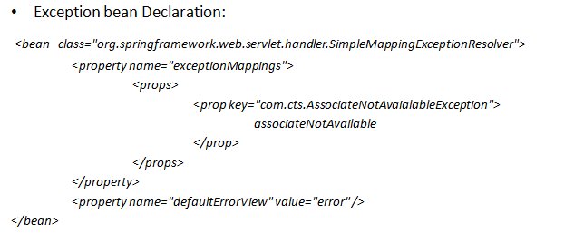
Exception Handling

Slide 11
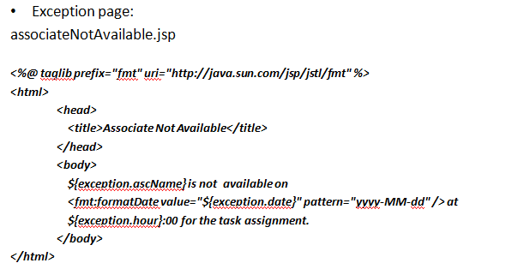
Exception Handling

Slide 12
Demo
Demo code for Validations and Exception Handling.

Slide 13
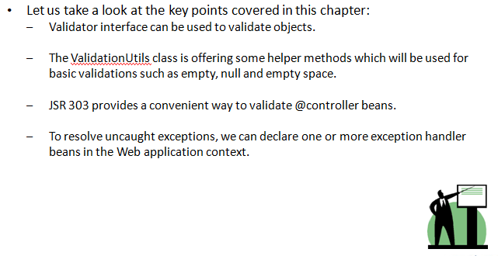
Summary

